Slide 1

Surveillance System Using ML
G.L. Bajaj Institute of Technology and Management
Greater Noida
PRINCE KUMAR (2001920139007) SUPERVISED BY :
VIPNESH CHAUHAN (1901920130191) DR. RAJNESH SINGH

Slide 2
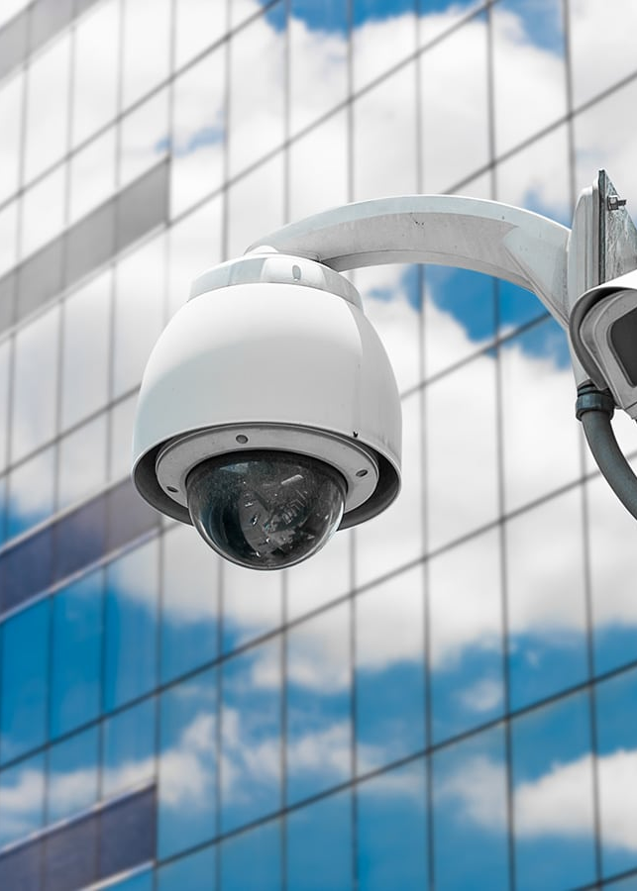
Introduction
In this world of 21st century, new technologies and new tools are coming up for living our life very easily. But it comes up with some dangerous risks. Security has become a major aspect in each and every field. One of the solution to protect you property from such threats is Video surveillance.
Video Surveillance helps us to keep an eye on intruders, and thus giving a sense of security to the owner of that property.
It is having number of applications in sectors like banks, hotels, hospitals, farms, industries, traffic points, labs etc.

Slide 3

Problem Statement(s)
1 2
3
Current Systems are Reactive
Increased Crime Rates
Security Personnel Dependability
Most surveillance systems are designed to merely record- not detect or prevent crime.
The rising crime rates are making it imperative to revisit security measures.
Human operators are limited in their abilities to monitor footage for extended periods without error.

Slide 4
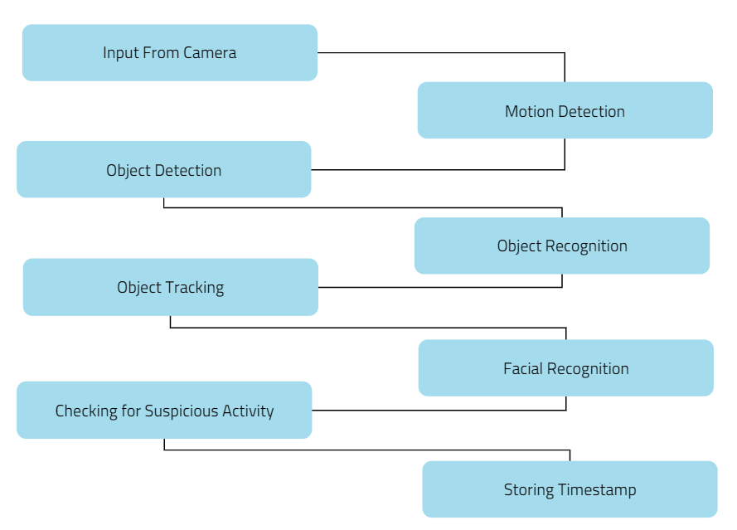
Flow Chart

Slide 5
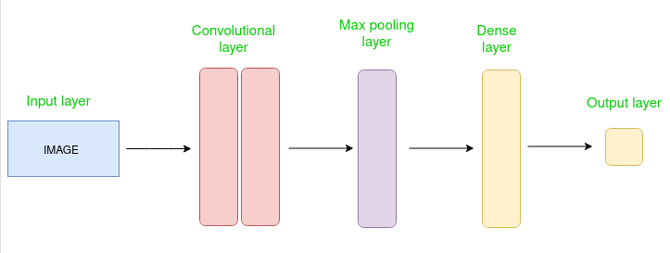
ALGORITHM
CNN

Slide 6
Objective(s)
Real-time Surveillance
The system leverages machine learning to detect and notify law enforcement of potential threats in real-time.
Increase Efficiency
AI reduces the workload of operators by flagging potential threats and enabling extensive searching.
Reliable Analysis
Sufficiently advanced algorithms ensure that the system can analyze complex footage and pick up abnormal patterns.

Slide 7
Literature Review
Deep Learning
The AI technology used for data analysis and to train the system.
1
2
3
Principle Component Analysis
The method used to identify suspicious activity in the footage.
Convolutional Neural Networks
A machine learning technique used for feature extraction in image analysis.

Slide 8
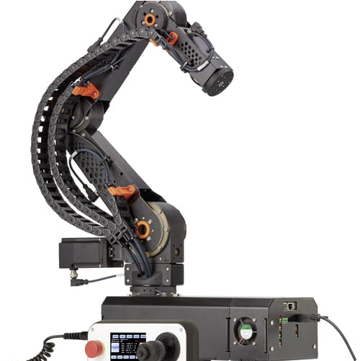

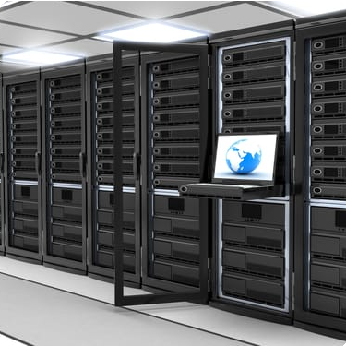
Materials and Methods
Parts
The system comprises security cameras, AI algorithms, and network systems for a real-time response.
Deployment
Technicians are required to install, configure, and deploy the system to set up and run seamlessly.
Data Storage
Collected data is usually stored in multiple data centers across the world and closely monitored.

Slide 9
Results
Real-time Response
Cost Effectiveness
Future Expansion
The system has shown a 60% increase in detecting suspicious activity than traditional surveillance measures.
By leveraging existing camera infrastructure and reducing the workload of security personnel, the system proves to be affordable and effective.
As the system grows with more data, AI algorithms can be improved, and the results will become more accurate.

Slide 10

Conclusion(s)
1
The Future is Here
2
Improved Security
It's clear that the implementation of machine learning in surveillance systems is the way forward.
Law enforcement agencies can access real-time footage and respond to potential threats quickly.
3
Increased Efficiency
The system reduces human error and reliance on traditional security measures resulting in faster response times.

Slide 11
Future Scope
1
2
3
Limitations Addressed
Further research can address the current limitation in 'False Negatives' (missed events) and 'False Positives' (false alarms).
Real-time Tracking
AI technology can be integrated with GPS technology to increase surveillance.
Facial Recognition
The system can be made to recognize faces and be programmed to respond when recognizable individuals appear on camera.

